Slide 1


Reach @
Uniquely Different
Reach @ Uniquely Different Ltd
Parents Guide
Date Issued: September 2020, Updated: 02nd March 2023

Slide 2
Contents
Section | What is there
1 | Reach @ Uniquely Different– Who, what, where
2 | My Stay – How, when, what
3 | What I need to know

Slide 3
SECTION 1 – REACH @ UNIQUELY
DIFFERENT

Slide 4

What is Reach @ Uniquely Different
Reach @ Uniquely Different welcomes referrals from all agencies, in particular where there is a risk of family breakdown and / or risk of significant harm. History of neglectful or abusive behaviour toward their child(ren). Person centred plans and positive parenting assessments and positive behavioural support plans will be carried out alongside local authority lead assessments.
Admissions for children for children 5-17
Accommodation and support or children, teenagers and young adults with Learning Disabilities , Autism and Social , Language and Communication difficulties
Accommodation and support for children, teenagers and young adults with disabilities, considered to be a child in need under Section 17 of the Children Act 2004,
Accommodation and support for children, teenagers and young adults with disabilities, considered to be a child at risk of significant harm Sect 47 of the Children Act 2004
Respite and short breaks
Short Term and bridging until long term placements are found
Independent living training and development
Transition to adult life
Providing equal opportunities for children and their families and staff regardless of sex, sexuality, race, colour, age, social class, religious belief, marital status, physical or learning disability, state of mental health or medical history in accordance with the Equality Act 2010.
Accommodating any combination according to needs of child / siblings.
The facilities that the centre offers:
A safe environment Transition opportunities Outdoor agency inclusion welcome
Bespoke needs 24 hour facilities Skills assessment facilities.
Sensory room Meeting room
Learning room – we are ASDAN providers Training facilities
Independent living skills area Outdoor secure play area
Computer access Family facility hire (for events)
Messy play room Wheelchair accessible facilities

Slide 5
What is Reach @ Uniquely Different
Underlying Ethos
Assessments are informed by the principles set out in the Working Together to Safeguard Children 2018 namely:
Individual Risk assessments and support plans and a PBS (positive Behavioural Support Strategy) to aid the child’s developmental and behavioural needs
Positive Parenting Assessment setting out how a child needs and prefers to be supported in areas identified assessment framework and positive parenting (PAMS). Reach @ Uniquely Different has several staff trained to use PAMS assessments. Whilst we do not offer this service currently, when working with children and families and assisting local authority in the assessment of positive parenting we will use PAMS documentation and skills index. The domains are as follows
Health Care
Emotional Care and Development
Communication
Personal Development
Stimulation
Guidance and Boundaries
Self and Identity
Social Presentation
Practical Life Skills (inside the home / safety)
Education
Family and Relationships
Caring responsibilities for another adult or a child
Reach @ Uniquely Different can provide 24 hour services:
A facility to be able to access (for day, evening, after school, weekend day sessions), practicing independent living transition skills into adulthood, ASDAN, lifestyle planning towards independence, emergency short term and respite, emergency facilities for SSD
There is an area outside where children can play as well as lots of space inside where there are areas for children to do all kinds of activities – painting, drawing, reading and watching TV. If there is anything you would like to do that we have not thought of, please ask and we will see what we can do!

Slide 6
What is Reach @ Uniquely Different
This is in accordance with:
The Children & Families Act 2018
The Childrens Act 1989 & Childrens Act 2004
The Mental Capacity Act 2005 – includes the Deprivation of Liberty Safeguards (DoLS)
Working together to Safeguard Children 2018
Child Sexual Abuse & Exploitation Guidance
Health & Social Care Act 2008
CQC Regulation 15: Premises and equipment
No Voice Unheard – No Right Ignored 2015
Autism Strategy 2014
Children and Families Act SEN 2914
CQC State of Care 2019
Good Intentions Good Enough? 2017
REACH Support for Living
Right to be Heard 2019
Serious Case Review, Bethany 2019
The Real Tenancy Test 2015
These are our Children – Lenehan Report 2017
Transforming Care National Response 2012
Valuing People 2001
Quality Assessment Framework - Children

Slide 7

CCTV in operation
Reach @ Uniquely Different uses CCTV surveillance to monitor certain areas of its premises 24 hours a day to aid the management of the safety and security of service users, staff, visitors, personal and business property. Those areas are limited to the external areas of the building and the communal areas inside the building. We have a duty under the GDPR to inform of CCTV being in operation.
If you do not consent to this, please contact us, otherwise consent will be assumed.

Slide 8

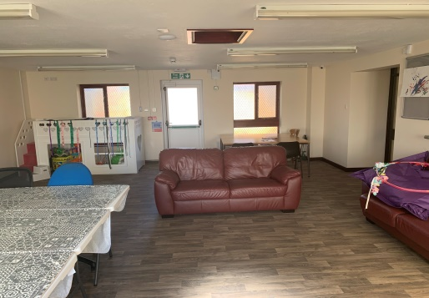
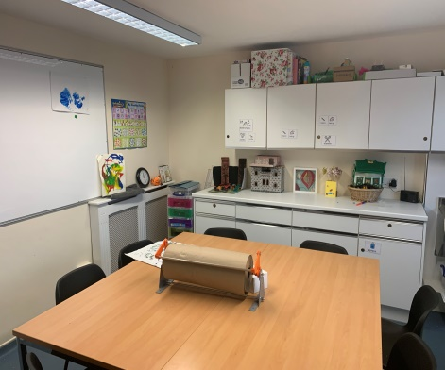
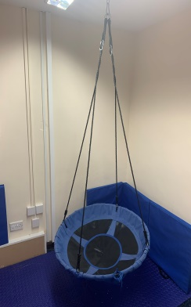
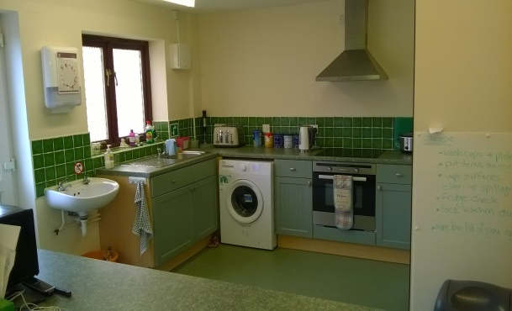
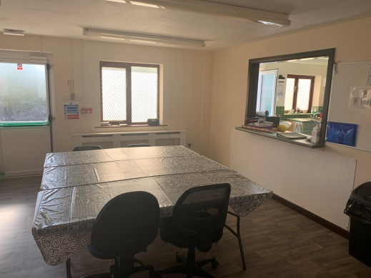
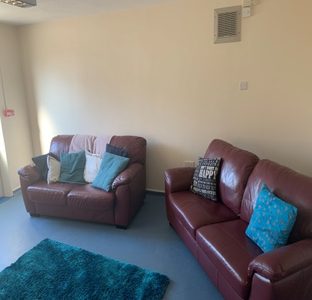
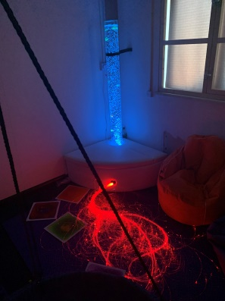
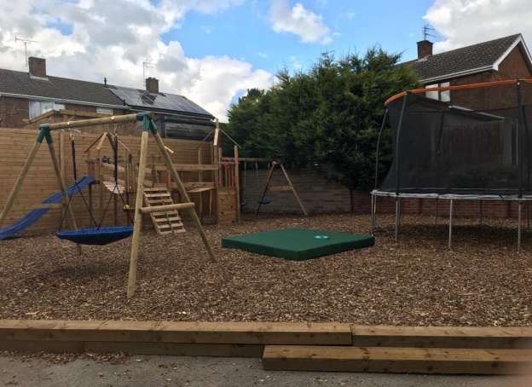
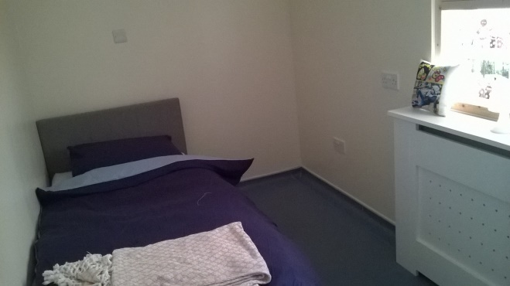
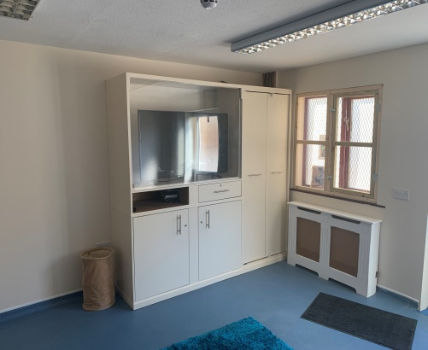
What does Uniquely Different look like?
Set out COVID-19 friendly

Slide 9
Who will be at Reach @ Uniquely Different?
There will be other children and teenagers staying at Reach @ Uniquely Different
Family members of children staying may visit and children using the resource centre
There are always your staff around.
During the day there will be more staff than at night because there are some extra people in the office.
If you want to talk to any of us please do, we are here to help you.
Sometimes it may seem very busy/noisy and there may be people who you don’t know around, staff know who is in the building and no-one is allowed to be there if they shouldn’t be. If you are worried, please tell us.
We make sure that visitors attending have their ‘own space’ and needs.

Slide 10
Will staff always be there?
Staff will be present at all times, allocated to your child
There will be staff available for you to talk to while you are at Reach @ Uniquely Different. We don’t want you to feel unsure or uncomfortable about anything.
We will use rooms on a timetable basis with facilities that meet your child’s needs.
We will always knock before we come into the rooms.
We know how important it is for you to have privacy and will endeavour to ensure this for you
Whilst your son/daughter/ relative is at Reach @ Uniquely Different we will ensure their staff are attending to their needs.

Slide 11
How we will help?
We will help with safe play, learning and development by;
Working with support workers by having activities and rooms set up and available for use
Person centred assessments that identifies individual needs
Positive behavioural support and strategies
Breaking down tasks into easily identifiable steps
Demonstrating tasks
Provision of pictorial prompts, symbols, diagrams, digital clocks
Use of visual aids / videos
Helping to support development needs on a gradual basis
Addressing issues, tackling a few issues at any one time to avoid the child feeling overwhelmed or inadequate
Repetition of instruction / input
ASDAN provision
Working with families to develop skills and approaches to enhance care and relationships between the parent, child and family

Slide 12
Admissions Procedure
With you, your social worker and team around the child(ren) will have discussed and recommended use of Reach @ Uniquely Different as a resource
We will offer you an opportunity to meet with us – at your home and/or the centre.
Arrange centre visit with support worker / supporter
We will discuss, agree the consent to support prior to admission, services identified.
Book suitable times and sessions according to your needs and needs of others at the centre.

Slide 13
Fees and Charges
Due to the individuality of each child, fees will be arranged dependent on the level of assessment or support required. We will work in conjunction with the referrer to ensure that the service provided is tailored to the specific needs and preferences of each family.
Invoices will be raised on a 4 weekly basis and payment is required within 30 days of the invoice date unless otherwise agreed in writing with Reach @ Uniquely Different.
Should the referring agency terminate the assessment prior to the agreed term, Reach @ Uniquely Different reserves the right to charge a minimum of one month period following the departure of the child / family.
Should the referring agency cancel a placement prior to commencement of the placement, Reach @ Uniquely Different reserves the right to charge a cancellation fee of 2 full weeks.
Funding can be provided via local authority, direct payments or private arrangement.
Funding can be charged;
Directly to funding authority
Directly to the person via Direct Payment, individualised budget, short breaks allocation

Slide 14
Rules and Regulations whilst staying at Reach @ Uniquely Different
During your stay at Reach @ Uniquely Different, we will work together to ensure that the following rules and regulations are followed and respected.
We request that pictures and locations are not shared on any Social Media (Facebook, Twitter etc.)
Please do not take photos of other visitors.
All visitors to adhere to Fire Safety and fire evacuation procedure
This building operates a No Smoking policy, and smoking is not allowed within the building.
Drugs and Alcohol are not permitted on the site.
Medicines to be locked in your medication safe located in allocated staff room (overnight stay) or office (day time).
Named visitors to be identified with placing officer. All visitors are required to provide photographic ID, before admission to Reach @ Uniquely Different. No overnight visitors allowed.
GDPR

Slide 15
If I am worried who can I talk to?
At Reach @ Uniquely Different, we aim to provide the best possible service we can deliver.
However, if there is an area where you are dissatisfied, please tell us. Unless we know we are unable to put it right.
Please note that should a complaint be made verbally the response will be verbal unless otherwise required, all written complaints will be responded to in writing.
In the event of you needing to make a complaint, we have a procedure to follow ensuring your complaint is dealt with professionally, confidentially and efficiently.
In the event of you not being satisfied then:
1. Approach or make an appointment with the Registered Manager who will complete a complaints record and deal with the issue as soon as possible. You will be provided with written account of any action taken within 28 days.
2. If this is not possible or you are still dissatisfied a complaint can be made to the Director (Responsible Person) Gloria Miller.
3. If you are unhappy with the outcome of this or you have a Child Protection/Safeguarding concern then contact:
Sir Michael Wilshaw
Her Majesty’s Chief Inspector for OFSTED
Ofsted
Piccadilly Gate
Store Street
Manchester
M1 2WD
Telephone: 0300 123 1231
Fax: 0300 123 3159
E-mail: enquiries@ofsted.gov.uk

Slide 16
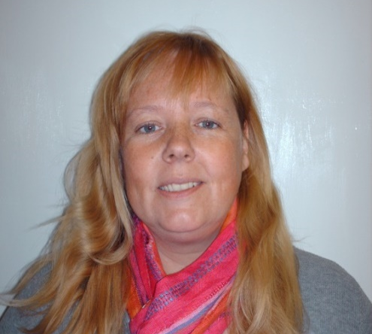
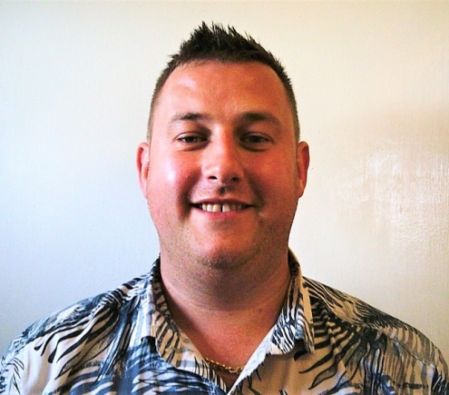
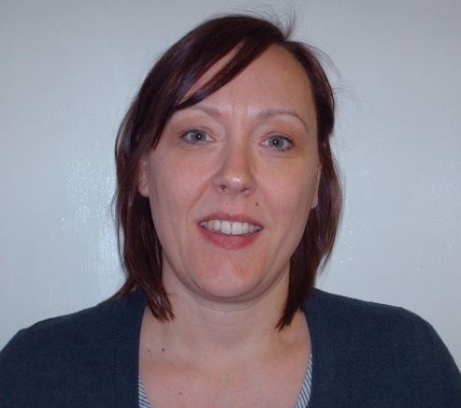
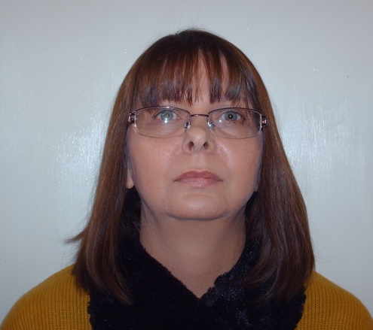
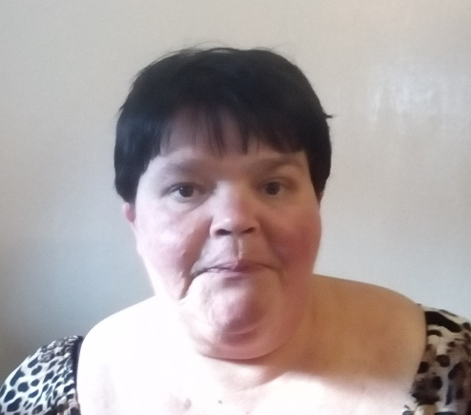
Who’s Who
Gloria
Responsible person,
Social Worker, ASDAN leader
David
Level 5 Manager
ASDAN leader
Tina
Financial officer
Nicola
Human Resources
Toni
Senior Key Worker

Slide 17
Enjoy your visit

