Slide 1

Reach @
Uniquely Different
Children’s Guide
Date Issue: September 2020
Updated: 02nd March 2023

Slide 2
Contents
Page Number | What is there
3-4 | What is Reach @ Uniquely Different
5 | What do you have at Reach @ Uniquely Different
6 | What does Reach @ Uniquely Different look like
7 | Who will be at Reach @ Uniquely Different
8 | Will staff always be there
9 | What are sessions
10-11 | ASDAN
12 | Who you can talk to if you have worries

Slide 3

What is Reach @Uniquely Different for?
We help families to make children/ adults feel safe and a safe place where you can be who you are and unique and different

Slide 4
The centre offers facilities for people to attend to
Feel accepted
Confident to be who you are
Have their individual achievement goals and needs met
Working to all laws and rules to keep you safe and happy

Slide 5
What do you have at Reach @ Uniquely Different?
There is a large area outside where you can play as well as lots of space inside where there are areas for you to do all kinds of activities – painting, drawing, reading and watching T.V. If there is anything you would like to do that we have not thought of, please ask and we will see what we can do!
Your own bedroom
Your own living area
Practise independent living
Sensory room
Messy play
Learning room
Craft area
Big central community room
ASDAN education
‘Archies Den’ 2 bedroom bungalow (adjoined)
‘Aimee's’ 1 bedroom bungalow (adjoined)

Slide 6

CCTV in operation
Reach @ Uniquely Different uses CCTV surveillance to monitor certain areas of its premises 24 hours a day to aid the management of the safety and security of service users, staff, visitors, personal and business property. Those areas are limited to the external areas of the building and the communal areas inside the building. We have a duty under the GDPR to inform of CCTV being in operation.
If you do not consent to this, please contact us, otherwise consent will be assumed.

Slide 7
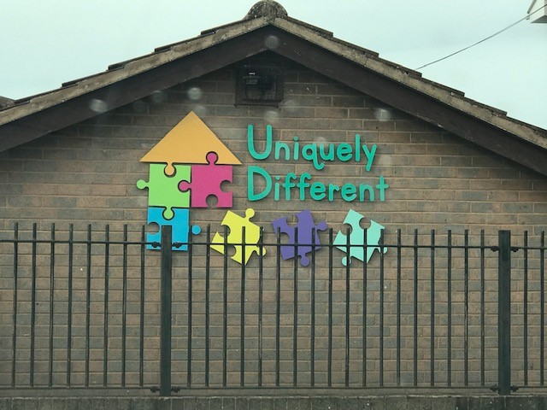
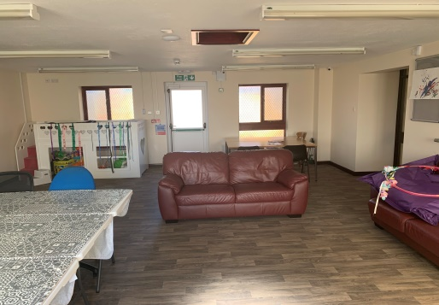
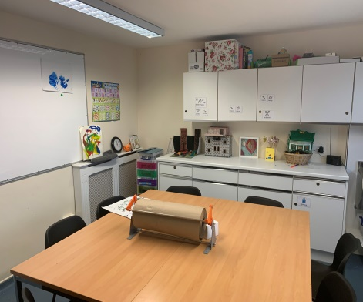
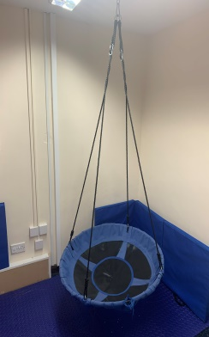
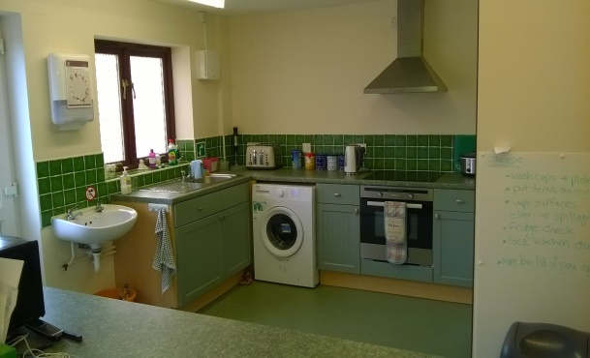
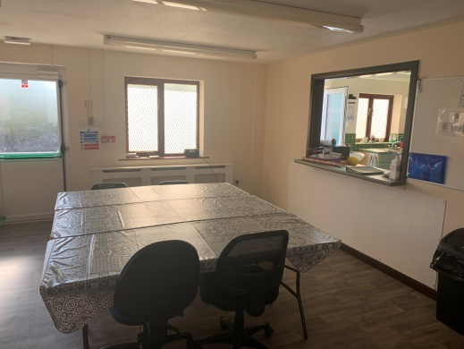
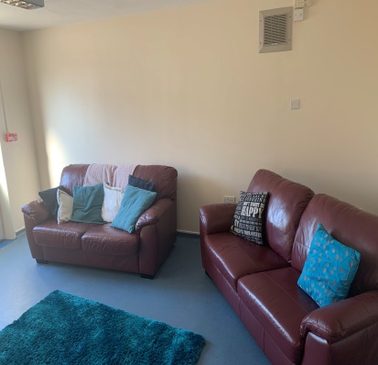
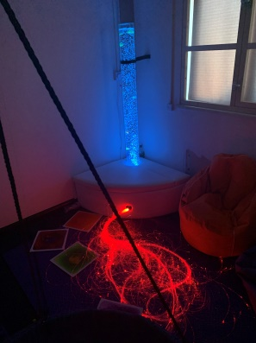
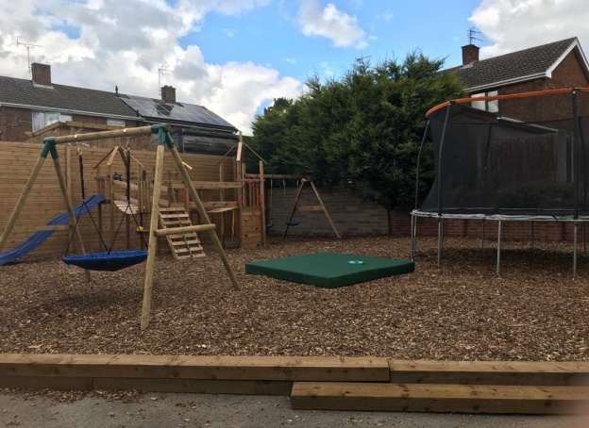
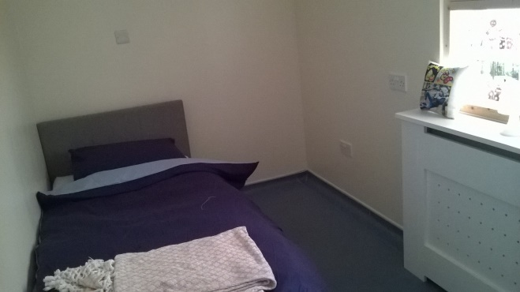
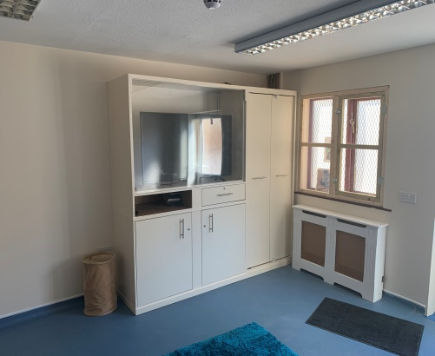
What does Reach @ Uniquely Different look like?
Set out COVID-19 friendly

Slide 8
Who will be at Reach @ Uniquely Different?
Your living space and bedroom is yours and private to you
There are always staff in the Office, you will have your own staff when you attend the centre
During the day there will be more staff than at night because there are some extra people in the office. You will probably see them at their computers or talking on the phone
If you want to talk to any of us please do, we are here to help you
Sometimes it may seem very busy/noisy and there may be people who you don’t know around, but don’t worry staff know who is in the building and no-one is allowed to be there if they shouldn’t be. If you are worried, please tell us
There may be other visitors spending time at Reach @ Uniquely Different

Slide 9
Will staff always be there?
There will always be staff available for you to talk to while you are at Reach @ Uniquely Different. We don’t want you to feel unsure or uncomfortable about anything.
When staff come to your chosen room, they will always knock first.
Your own staff will support you in the bathroom/bedroom while you are getting dressed or having a bath/shower. We know how important it is for you to have privacy
While you are here your staff will spend time with you. Other visitors and their staff may be around when.
  Moving around the facilities
  Meal times
  Coming in and out the centre

Slide 10
What are Sessions?
Reach @ Uniquely Different is accommodation and a centre for you to enjoy relaxing, playing, hobbies, sensory activities, cooking, chilling, working towards independence, meeting friends
Your own living area to develop personal skills and lots of new experiences
Those choosing ASDAN – These sessions are a bit like chatting to your teacher at school – ideas and action planning with you and your support worker you can talk about what you would like to do and learn.

Slide 11
ASDAN
Staff at Reach @ Uniquely Different are here to help you gain national recognised certificates of achievements and skills like developing communication skills, Out in the community and developing numeracy skills.
  Whilst at the centre we aim to offer an environment that promotes toileting, hand washing and wiping (Covid)
  Keeping tidy – independently to put items away, rubbish in the bin. .
    Protective Behaviours – using the right words and actions to keep you safe

Slide 12
Emotional Warmth – Positive regard, say hello and goodbye, listen and talk to you
Play – how to talk, help you and interact with children and play with them .
Routines – having set routines during the day, so you feel safe and confident whilst you are here.
Sensory needs - to explore sensory pleasures and dislikes
Managing behaviour – exploring the reasons why we behave as we do, and to promote positive behaviours and communication
Education/ life skills- use of ASDAN / working with your school
Relationships – how to get on with different people in your family and people around you

Slide 13
If I am worried who can I talk to?
If you are unhappy about anything whilst being at Reach @ Uniquely Different, you can speak to any member of staff you choose to
You can talk to your parent/carer, if you wish to
You can also talk to:
  A teacher
  Social Worker
  Guardian
  Foster Carer (if you are still spending time with them)

Slide 14
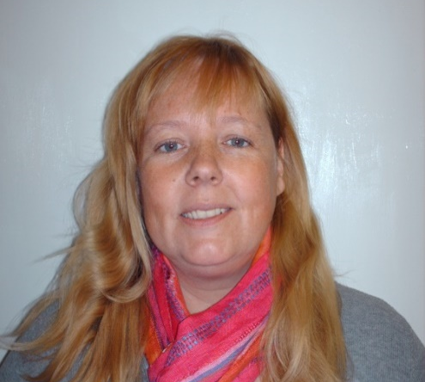
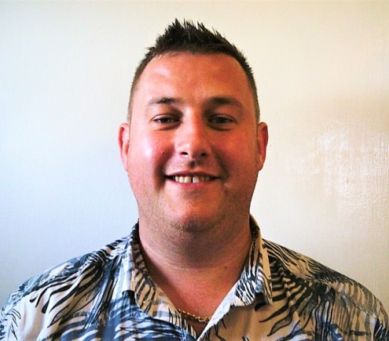
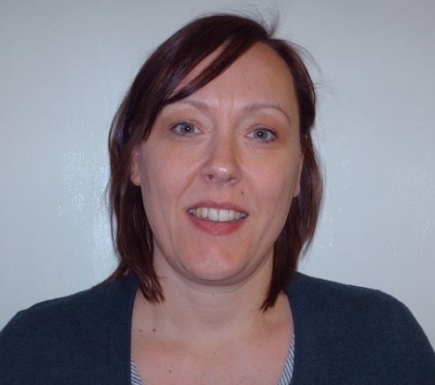
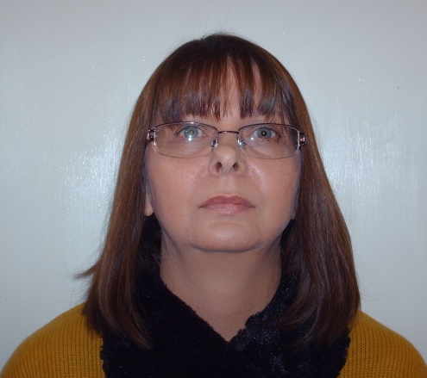
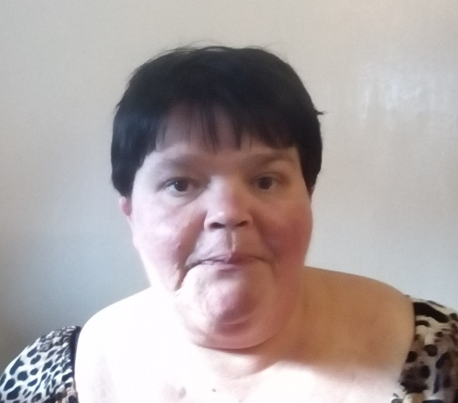
Who’s Who
Gloria
Responsible person,
Social Worker, ASDAN leader
David
Level 5 Manager
ASDAN leader
Tina
Financial officer
Nicola
Human Resources
Toni
Senior Key Worker

Slide 15
Enjoy your stay

